Slide 1
SWEBOKs

Slide 2
O que é o SWEBOK?
Software Engineering Body of Knowledge (SWEBOK) is an international standard ISO/IEC TR 19759:2005 specifying a guide to the generally accepted Software Engineering Body of Knowledge.
https://www.computer.org/education/bodies-of-knowledge/software-engineering
Temas divididos em Knowledge Areas (KA)

Slide 3
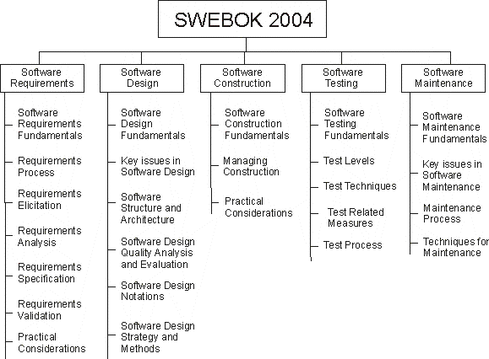
Versão de 2004 – Parte A

Slide 4
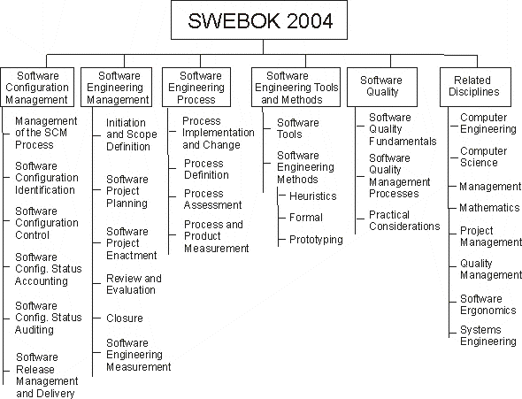
Versão de 2004 – Parte B

Slide 5
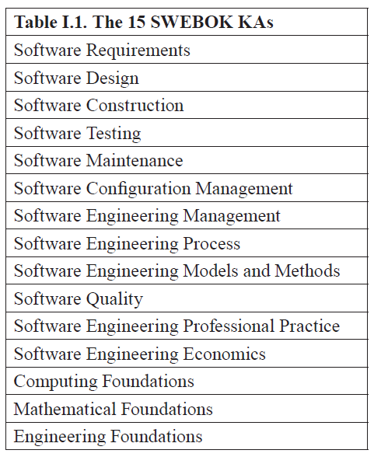
SWEBOK 3 - 2014

Slide 6
SWEBOK V4 – Lançado em 2024 18 Knowledge Areas
1. Software Requirements
2. Software Architecture
3. Software Design
4. Software Construction
5. Software Testing
6. Software Engineering Operations
7. Software Maintenance
8. Software Configuration Management
9. Software Engineering Management
10. Software Engineering Process
11. Software Engineering Models and Methods
12. Software Quality
13. Software Security
14. Software Engineering Professional Practice
15. Software Engineering Economics
16. Computing Foundations
17. Mathematical Foundations
18. Engineering Foundations

Slide 7
SWEBOK - Disciplinas relacionadas
Business Analysis
Computer Engineering
Computer Science
Cybersecurity
Data Science
General Management
Information Systems and Technology
Mathematics
Project Management
Quality Management
Systems Engineering

Slide 8
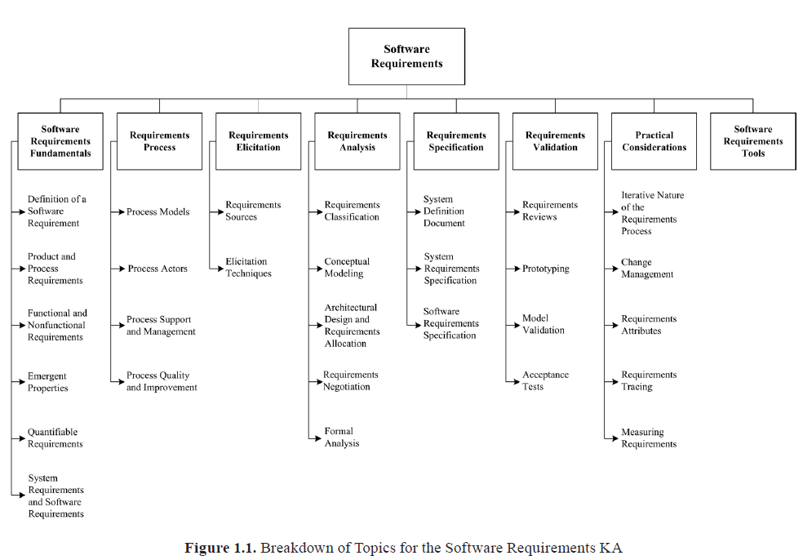

Slide 9
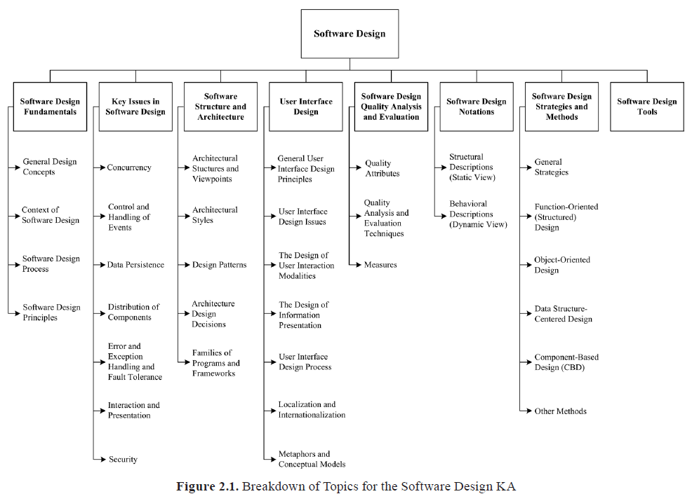

Slide 10
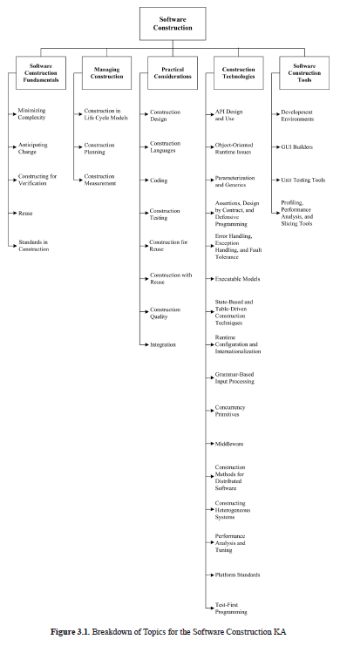

Slide 11
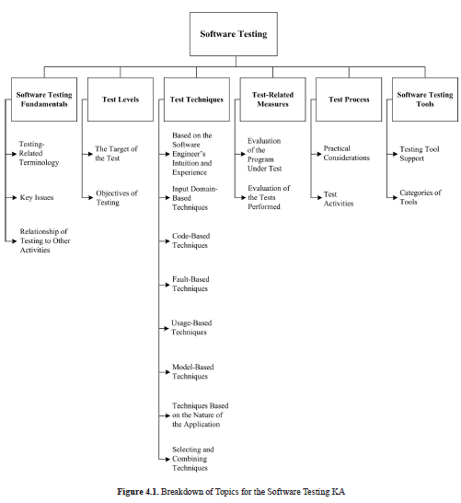

Slide 12
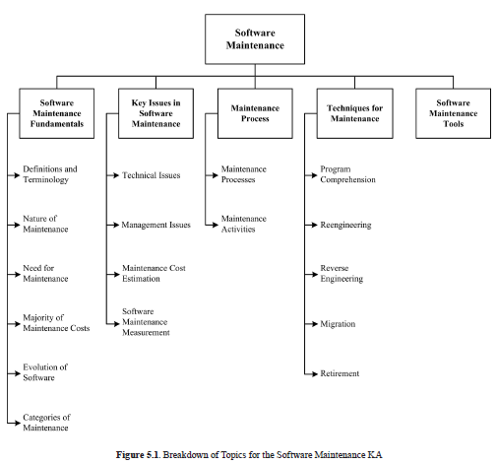

Slide 13
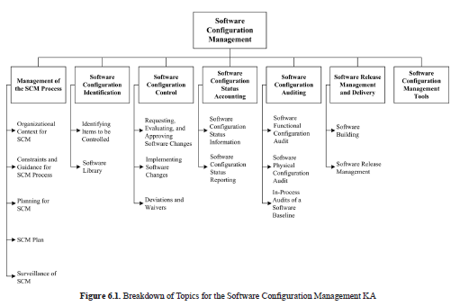

Slide 14
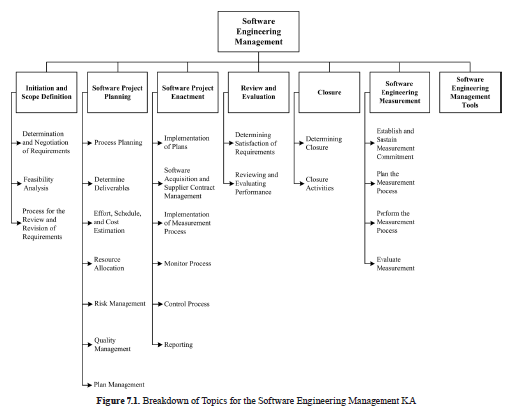

Slide 15
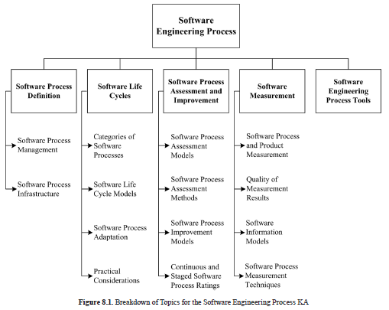

Slide 16
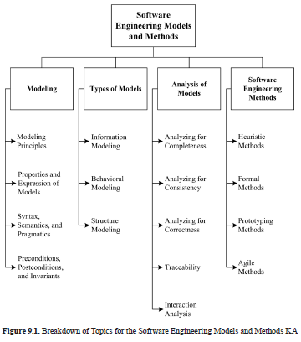

Slide 17
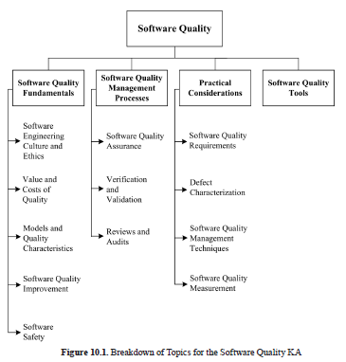

Slide 18
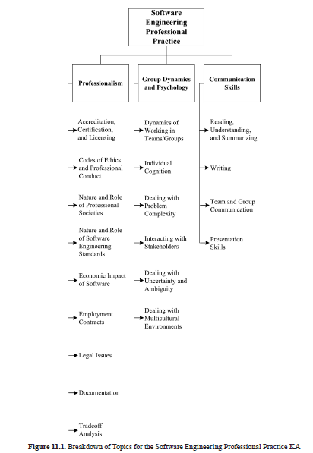

Slide 19
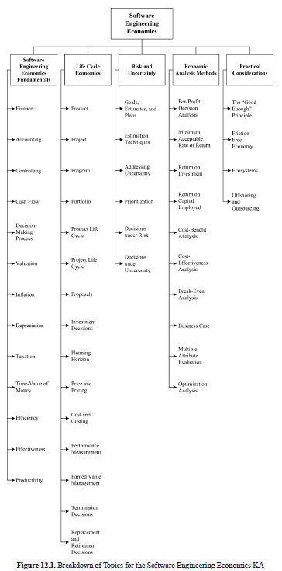

Slide 20
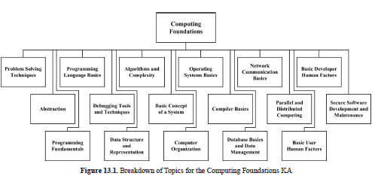

Slide 21
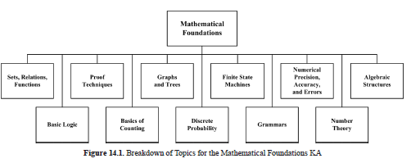

Slide 22
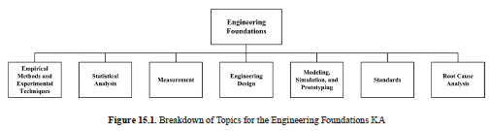

Slide 23
Tarefa Prática
Ler capítulos 10 e 11 do SWEBOK 4.0

